Slide 1
Investigation of Internal vs Forced Climate Variability: A Summary and Expansion of findings by Dr. Isaac Held
Kenneth Pryor
Tahmid Abtahi

Slide 2
Presentation by Dr. Isaac Held: Summary and Comments
Background of Dr. Isaac Held
Statement Summary
Exploration of major topics addressed by Dr. Held:
Forced vs internal climate variability
Volcanic Eruptions
Milankovitch Cycles
Solar Cycles: influence of sunspot activity on global warming hiatus and Indian summer monsoon rainfall
Conclusion and topics for further research

Slide 3

Dr. Isaac Held: Research and Science Background
Senior Research Scientist at NOAA/GFDL, specializing in:
Atmospheric and oceanic fluid dynamics/geophysical turbulence
Climate dynamics/global warming
Professor in the Geosciences Department/AOS program at Princeton University
Climate response to 1) variability in the amount of incident solar radiation, 2) volcanic eruptions and associated aerosol loading, 3) variability in the concentration of greenhouse gases; general circulation of the atmosphere; and the assessment and tuning of climate models.

Slide 4
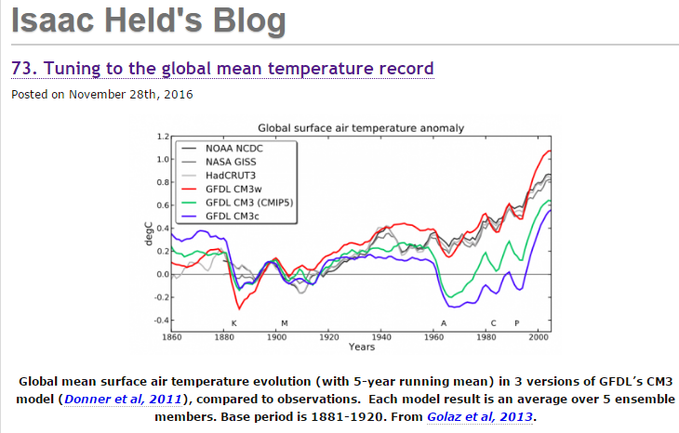
Notes:
The goal of climate modeling is to develop multi-purpose climate simulators. The same model generating the global mean temperature in this figure is also used to simulate the response of tropospheric winds to the Antarctic stratospheric ozone hole, for example. But as we all know, some aspects of the simulations in our current models are robust while others are sensitive to model uncertainties and may be tunable to some extent within the context of a particular model. If you have a simple model that you are fitting to some data, there is no problem in describing in detail how you decided on the model, the free parameters, the fitting procedure, the data used, etc. it can be more of a challenge to make the development path of a climate simulator fully transparent.
A question that gets a lot of attention is whether you should try to tune your model to be consistent with the evolution of global mean temperatures (GMT) over the past century, or if you should withhold that particular iconic data set during model development, justifying its use as a measure of model quality.
My impression is that it is the advent of models incorporating indirect aerosol effects – the effects aerosols have on climate through their modification of clouds — that has really brought this question to the forefront. The evolution of GMT is controlled by a combination of climate sensitivity, radiative forcing, and internal variability. I don’t know of any way to robustly increase or decrease a model’s internal variability on decadal and longer time scales. But in a given model you can often find ways of altering the model’s climate sensitivity through the sub-grid convection and cloud schemes that affect cloud feedback, but you have to tread carefully because the cloud simulation exerts a powerful control on the atmospheric circulation, top-of-atmosphere (TOA) and surface radiative flux patterns, the tropical precipitation distribution, etc. But including aerosol indirect effects on radiative forcing has made it easier to generate a greater variety of 20th century simulations without affecting other aspects of the climate simulation as strongly.
The figure at the top from Golaz et al, 2013 shows simulations from three versions of the CM3 coupled atmosphere-ocean model developed at GFDL (Donner, et al 2011). This was our lab’s first attempt to incorporate the indirect effects of aerosols in a climate model. The three models are the result of varying a single parameter that controls the amount of cloud water required for the onset of coalescence in the models microphysics scheme, which in turn controls the water content of clouds. (Other parts of the model need to be adjusted to retrieve a good global mean TOA energy balance but are not the main drivers of this behavior.)
One of these versions clearly provides a better fit than the others. These differences are primarily due to aerosol radiative forcing, not climate sensitivity. The model that is most consistent with the observed evolution has the smallest aerosol forcing. (The figure shows 5-member ensemble means; individual realizations do not change the basic picture.) As described in Suzuki et al 2013, the value of the parameter that provides the best fit is not the one preferred by comparing directly to cloud observations; the settings that result in larger aerosol forcing seem more justifiable at face value. There is nothing mysterious about this. It’s an example of the familiar tension resulting from the imperfections of any model and the need to weight different performance metrics relative to each other.

Slide 5
Types of Climate Variability
Internally generated variability: generated exclusively by dynamical processes operating within the ocean and atmosphere.
Extratropical wintertime circulation
Boundary forced variability: attributable to the year-to-year variations in the boundary conditions.
Sea surface temperature over tropical oceans
Variations in soil moisture and vegetation over mid-latitude continents
Externally forced variability: volcanic eruptions, variations in solar emission, or changes in atmospheric composition induced by human activities.

Slide 6
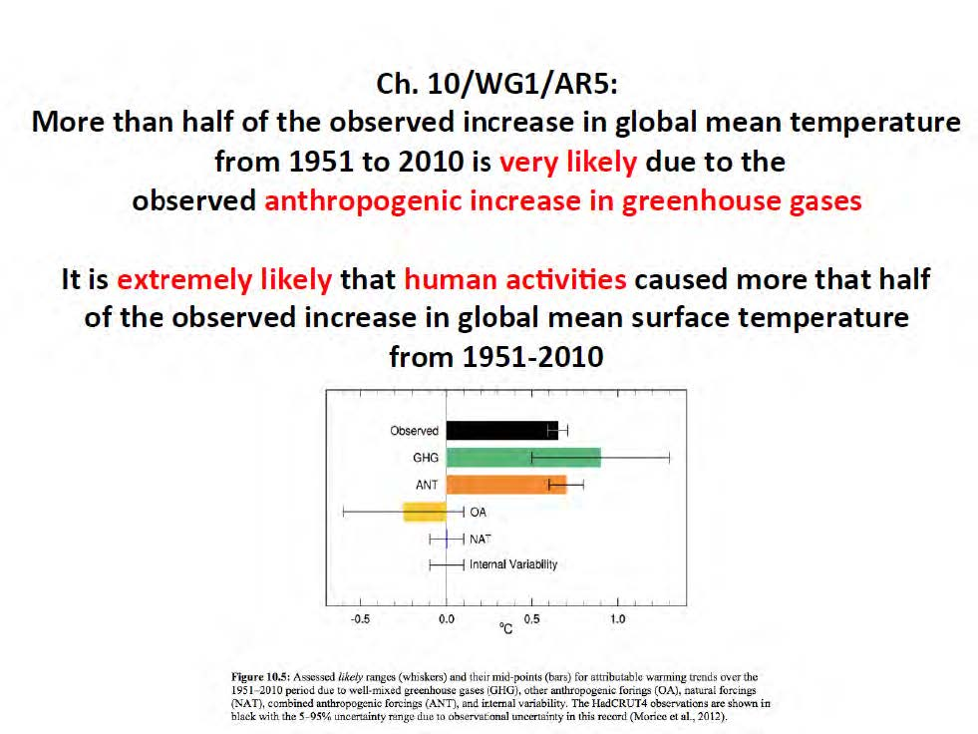
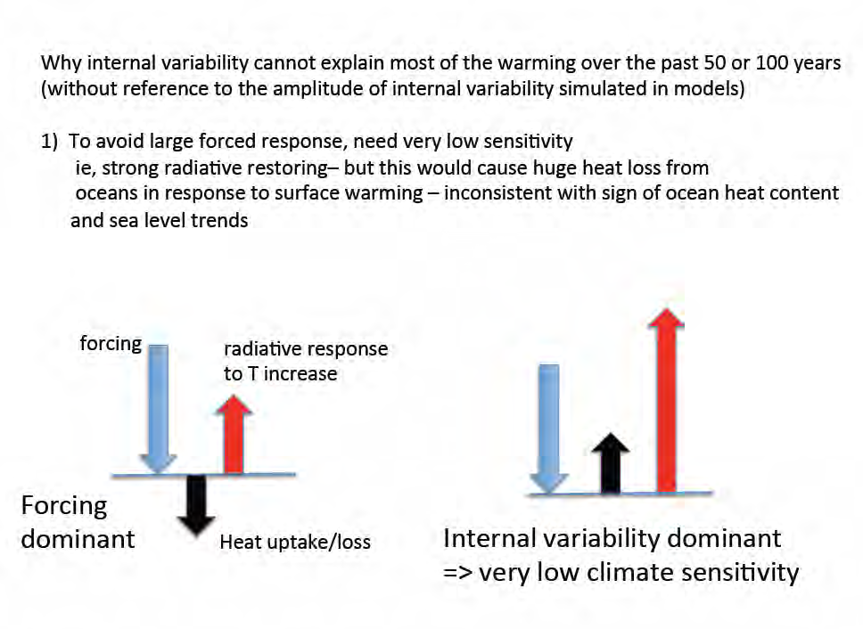
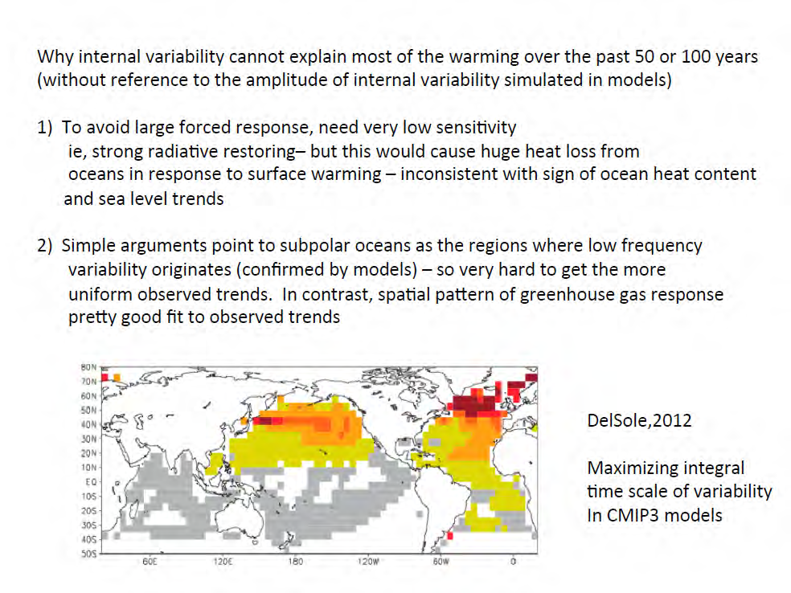
Internal vs Forced Variability
Climate sensitivity = λ = dT/dF
Notes:
“If you are saying it's mostly internal variability, you are talking about a very low-sensitivity system compared to the consensus picture, which means that we are talking about, say observed warming. So, you would have a huge outgassing of heat from the ocean because that's what you mean by "low-sensitivity model." For the same warming, you get a huge output
of energy trying to restore that.” Observations don’t support this process.
“Where do you expect low-frequency variability to emerge in the coupled climate system? It's going to emerge at high latitudes because, where you have memory on these multidecadal time scales is in the deep ocean.”
“And where is the deep ocean coupled efficiently to the surface? It's in subpolar regions. That's where the ocean is least stratified. There was a nice paper by 12 Del Sole looking at the models. And
he finds a pattern in all the models that have the largest integral time scale or decorrelation time. They are at high latitudes, especially the northern North Atlantic. “
“In fact, in a forced response, you expect to see an orthogonal pattern, more or less, because those are the regions that are coupled strongly to the deep ocean. You basically have big heat
capacity. So, you have the smallest response to the forcing-- so, it shouldn't be that hard to separate internal variability from forced patterns. They tend to have the opposite structures. And this doesn't look -- and basically, we don't see subpolar-dominated warming over the ocean. In the subpolar North Atlantic, we have seen very little warming over the century time scale. Over the last years, we have seen quite a bit. And that's why a couple of people talked about there might have been some contribution to the recent ramp-up, say, of the last 30 years from the North Atlantic variability, which is entirely plausible.”

Slide 7
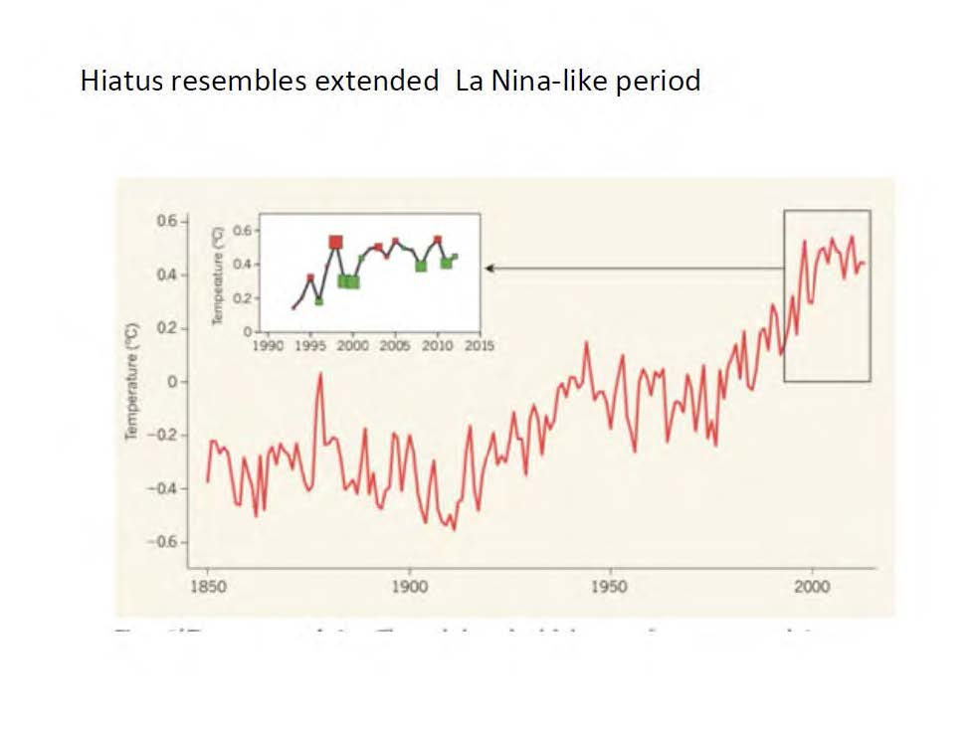
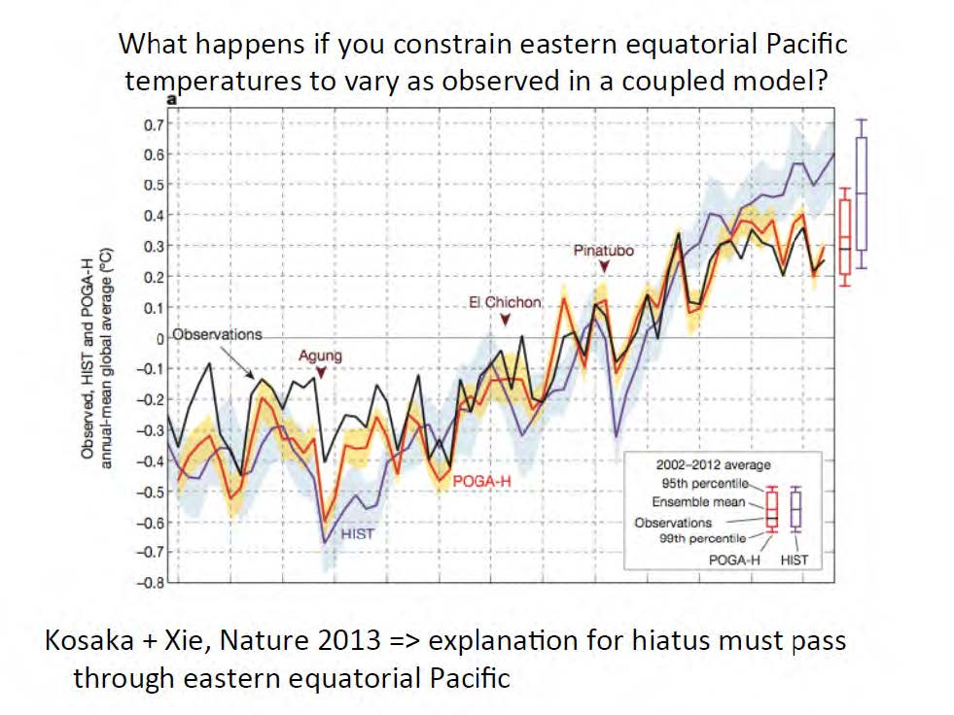
Internal vs Forced Variability
Notes:
Held: “I like the word "hiatus." This [next page] is the way I plot it. This is a standard Hadley Center data set. And this is just a blowup showing El Niño years and La Niña years. The red is El Niño and the green is La Niña by some standard definition. And the magnitude of these boxes is the magnitude of the El Niño or La Niña. And you can plot this in different ways. Superficially, a lot of the hiatus is, it looks like an extended La Niña-like period.”

Slide 8
Volcanic Eruptions

Slide 9
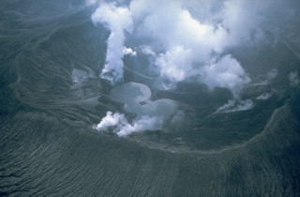
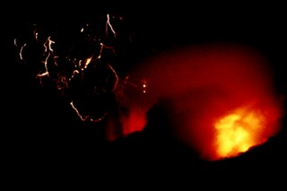
El Chichon, Mexico: March-April 1982
Lava dome volcano
Powerful explosive eruptions of high-sulfur, anhydrite-bearing magma that destroyed the summit lava dome and were accompanied by pyroclastic flows and surges that devastated an area extending about 8 km around the volcano.
Large SO₂ emissions (8000 kilotons) into the stratosphere that resulted in -0.3C global temperature anomaly during 1982.

Slide 10
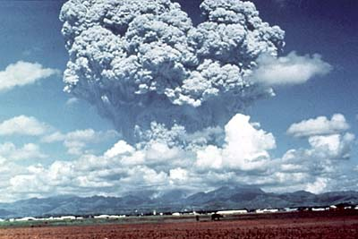
Mt. Pinatubo, Philippines: June 1991
Stratovolcano, caldera
One of the world's largest volcanic eruptions of the 20th century, ejected massive amounts of tephra and produced voluminous pyroclastic flows. The eruption caused hundreds of fatalities and major damage with severe social and economic impact.
Extremely large SO₂ emissions (18000 kilotons) into the stratosphere that resulted in -0.2 to -0.3C global temperature anomaly from 1991 to 1993.

Slide 11
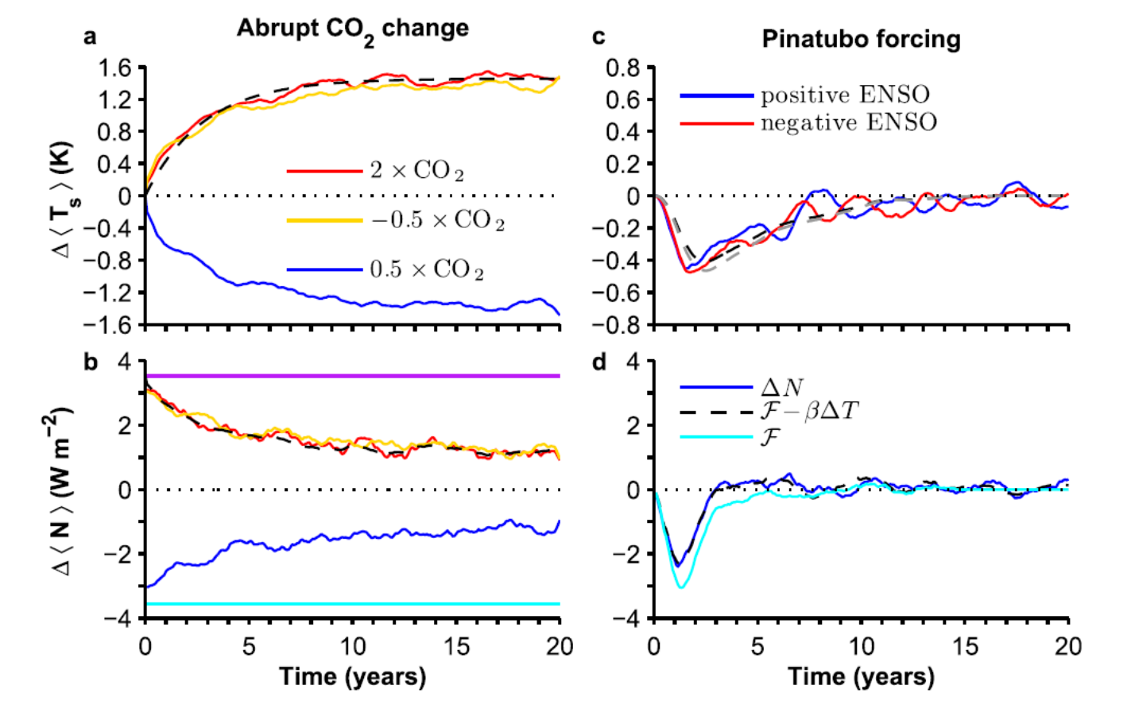
From Merlis et al. (2014)
Notes:
FIG. 1. (a) Change in global-mean surface temperature for abrupt CO2 simulations (2 3 CO2, red line; 0.5 3 CO2, blue line; and reflection of 0.5 3 CO2 about zero, yellow line) with black dashed line showing the estimated parameters (Table 1) of the two-box model [(4)]. (b) Change in global-mean TOA net radiation [colors as in (a)], radiative forcing indicated by straight lines, and net radiation implied by the best estimate of b (black dashed line). (c) Change in global-mean surface temperature for Pinatubo simulations with dashed lines showing the integral fit TCS estimate plotted with the CO2 time scale (positive ENSO, black, and negative ENSO, gray). (d) Change in global-mean TOA net radiation for positive ENSO phase simulations (blue), radiative forcing (light blue), and net radiation implied by the best estimate of b (black dashed line). Negative ENSO phase simulations are similar (not shown). All quantities shown are 12-month running time averages of the ensemble mean of CM2.1 simulations.

Slide 12
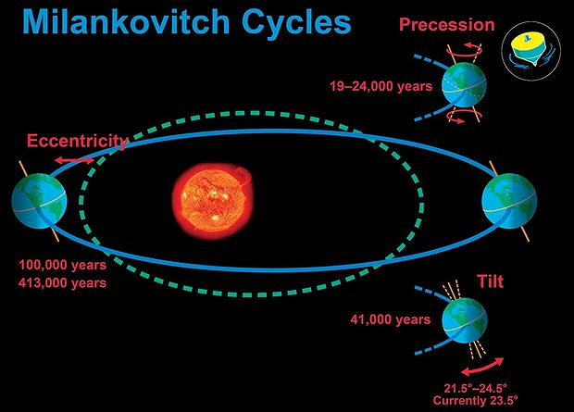
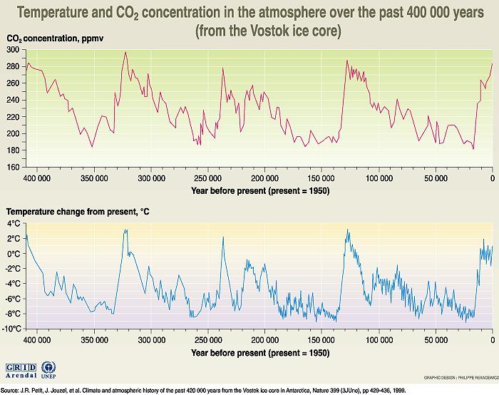
Milankovitch Cycles

Slide 13
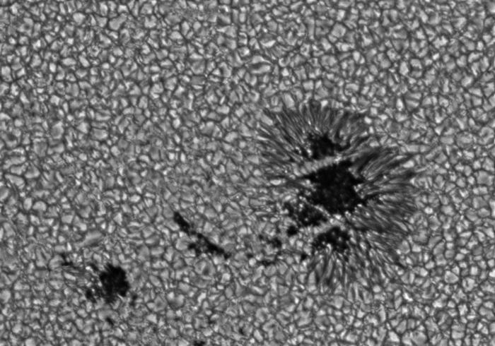
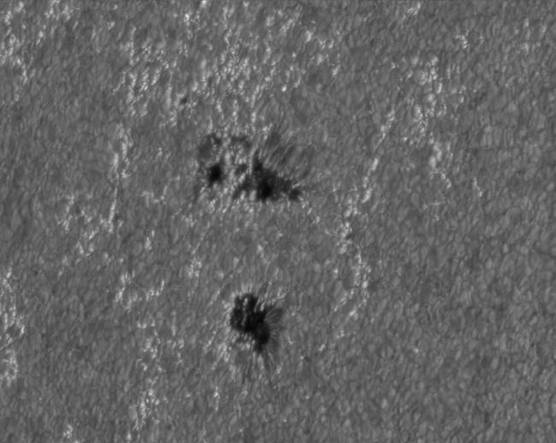
Solar Cycles - Sunspots
Sunspots appear as dark spots on the surface of the Sun.
Temperatures in the dark centers of sunspots drop to
about 3700 K (compared to 5700 K for the surrounding photosphere).
Faculae are bright areas most easily seen near the limb of the
solar disk. During a sunspot cycle, the faculae outnumber
sunspots and make the Sun appear slightly brighter at sunspot
maximum that at sunspot minimum.

Slide 14
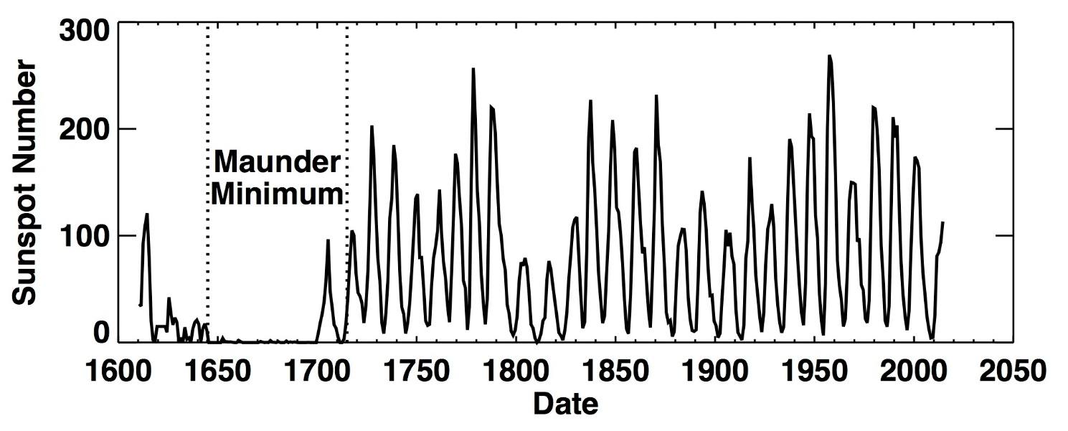
Solar Cycles - Sunspots
Dalton Minimum
Little Ice Age

Slide 15
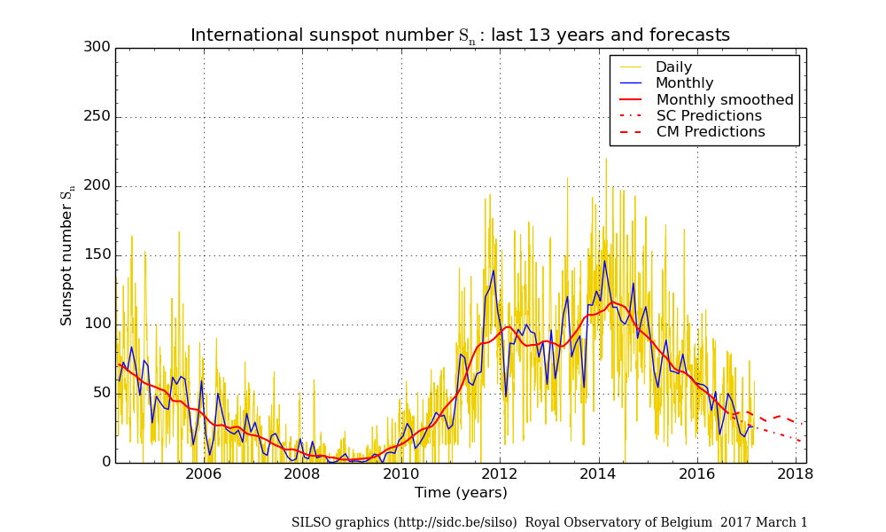
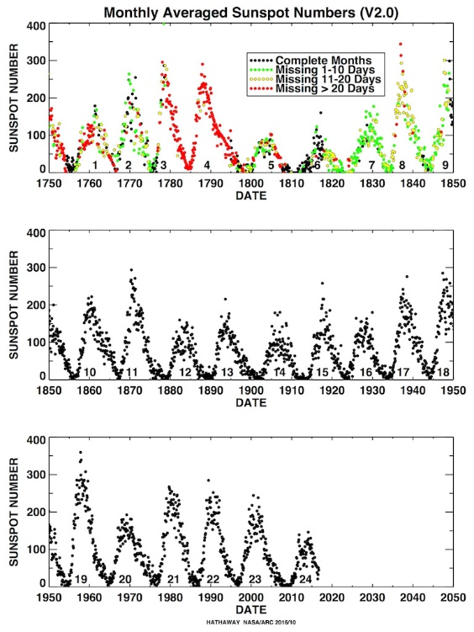

Slide 16
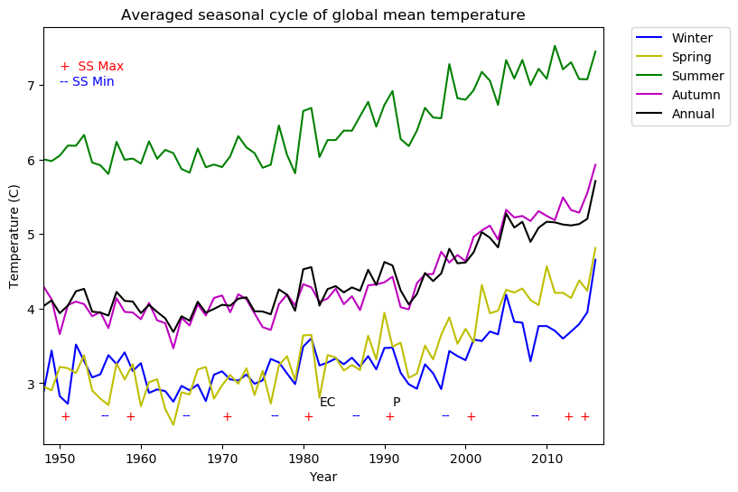
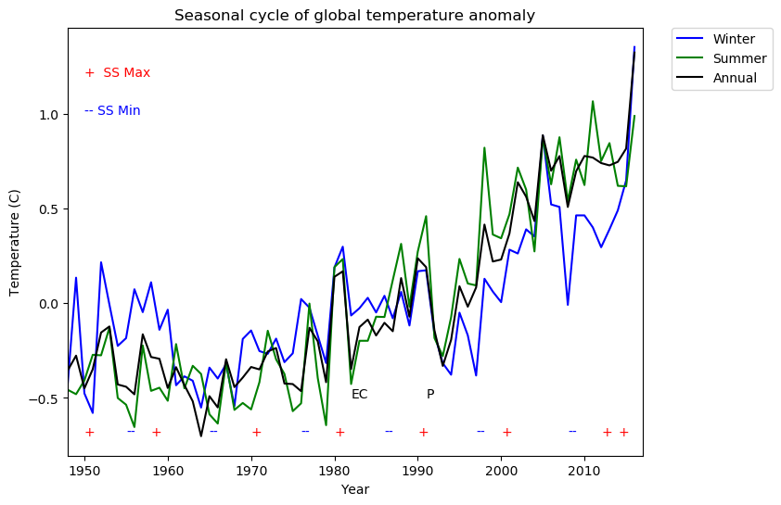
Global Seasonal Temperature vs. Anomaly

Slide 17
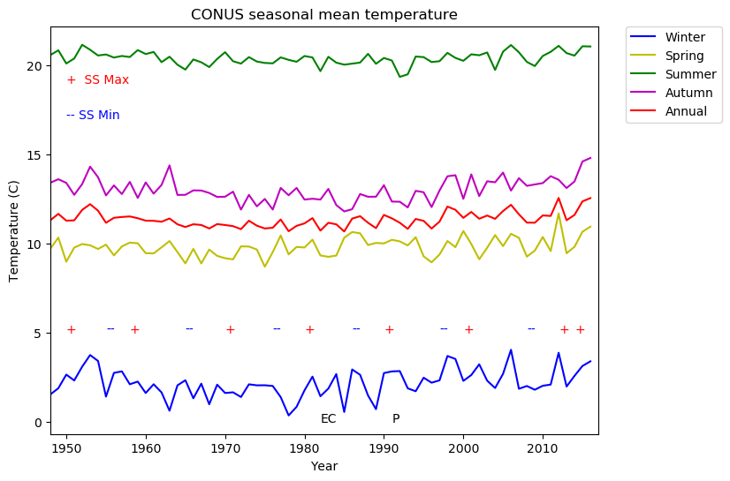
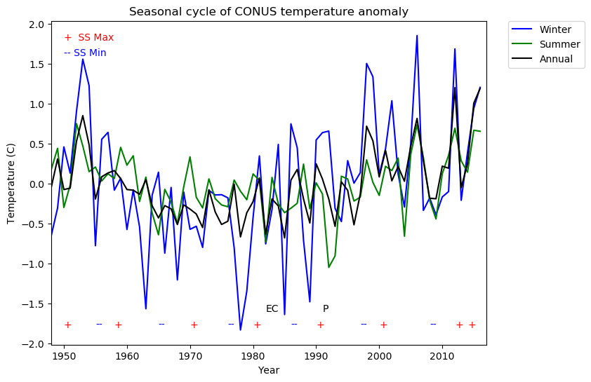
CONUS Seasonal Temperature vs. Anomaly

Slide 18
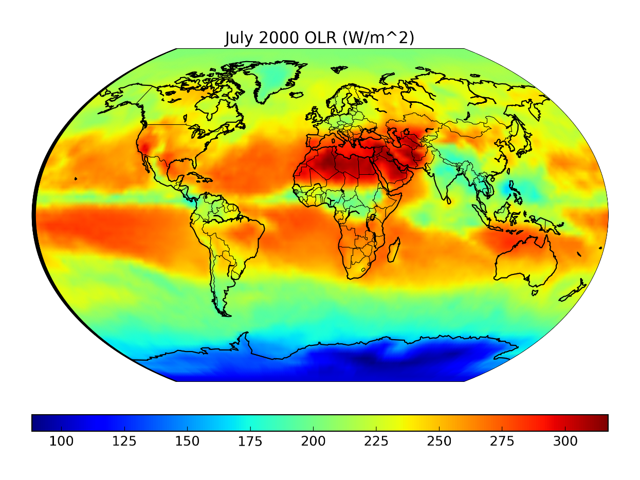
Outgoing Longwave Radiation (OLR)
OLR is emitted from Earth and the atmosphere out to space in the form of thermal radiation. The flux of energy transported by OLR is measured in W/m².
OLR data at the top of the atmosphere are observed from the Advanced Very High Resolution Radiometer (AVHRR) instrument aboard the NOAA polar orbiting satellites.
For this study, OLR is an important proxy measurement that represents convective cloud development and associated precipitation, since cloud top temperatures are an indicator of cloud height.

Slide 19
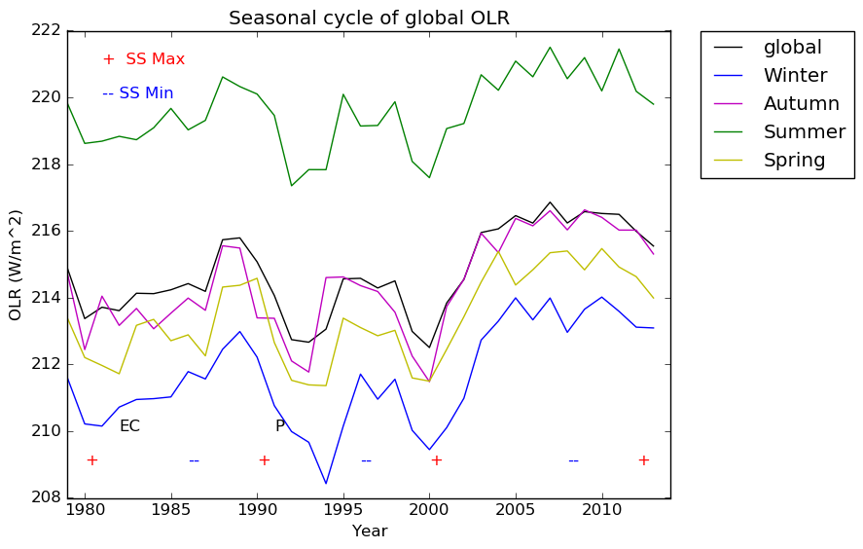
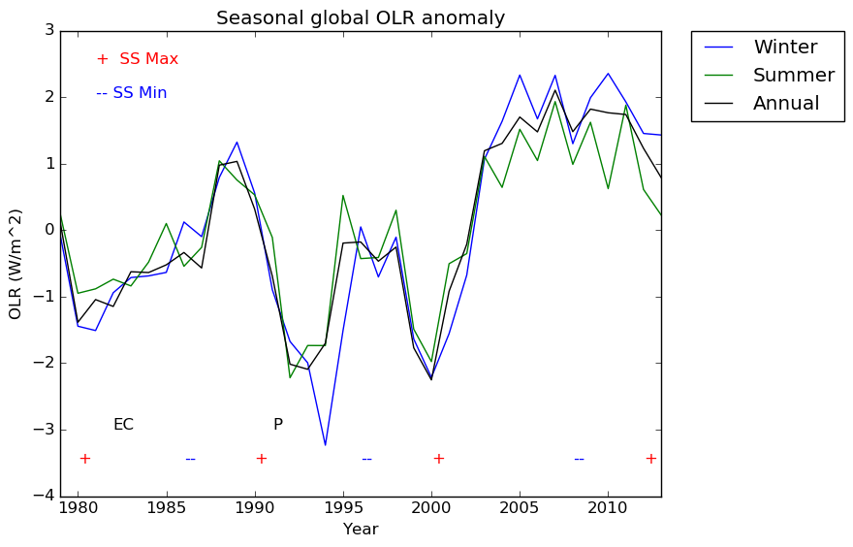
Global Seasonal OLR

Slide 20
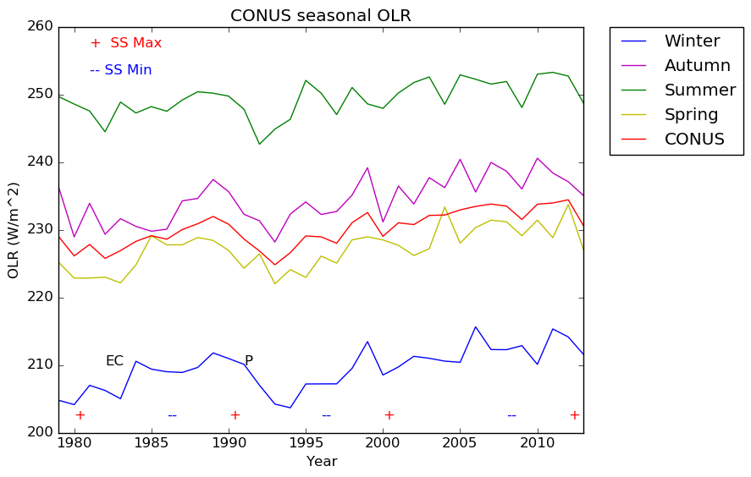
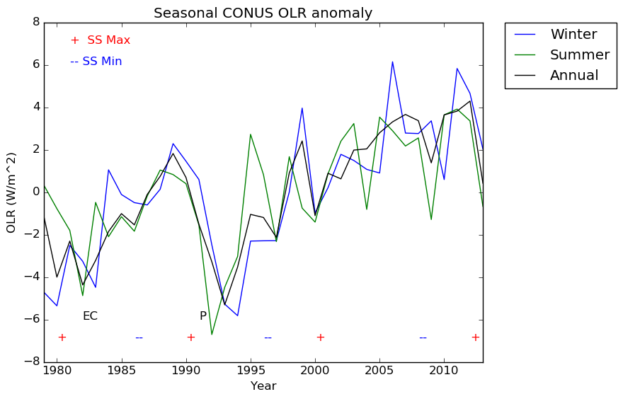
Conus Seasonal OLR

Slide 21
Influence of Solar Cycles on Indian Monsoon
Rao (1976) documented a relationship between sunspot activity and seasonal rainfall over India: “Jagannathan and Bhalme (1973) have brought out evidence that the seasonal rainfall depends upon sunspot activity. The rainfall is larger during sunspot maximum than during sunspot minimum over North Assam, North Bengal, Bihar and sub–Himalayan East Uttar Pradesh and the central parts of the Peninsula”.
Indian summer monsoon rainfall distribution patterns also vary with sunspot cycles and result from the development of anomalous circulation features:
During a sunspot maximum, negative pressure anomalies (monsoon trough) are displaced farther northward to the foot of the Himalayan mountain region- a condition typically associated with monsoon breaks.
During a sunspot minimum, the core of negative pressure anomalies is displaced farther southward over Orissa-Madhya Pradesh-Rajasthan- a condition typically associated with active monsoon conditions.

Slide 22
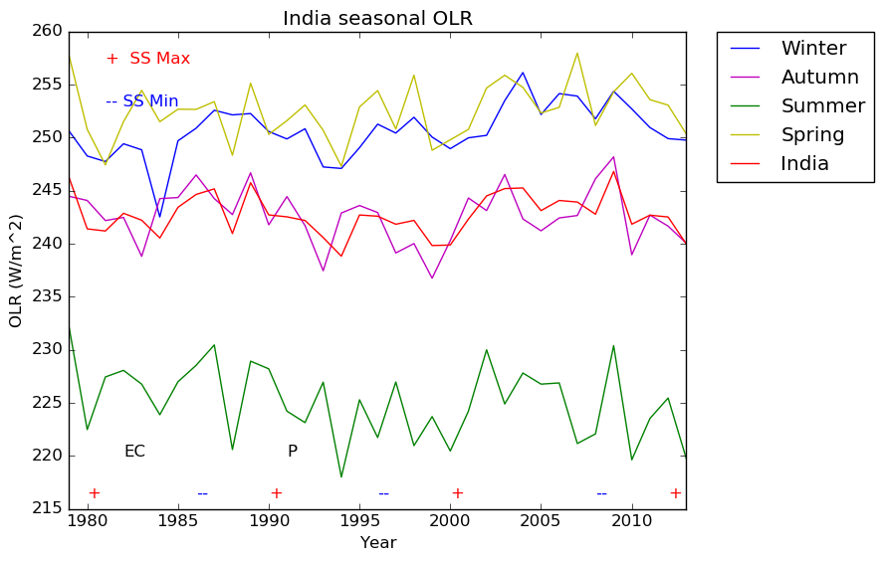
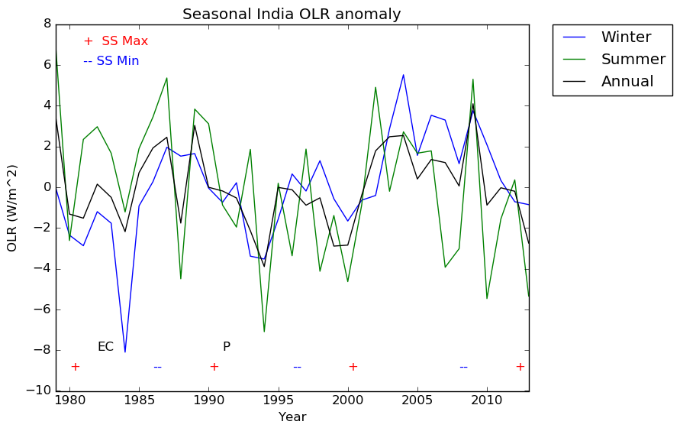
India Seasonal OLR

Slide 23
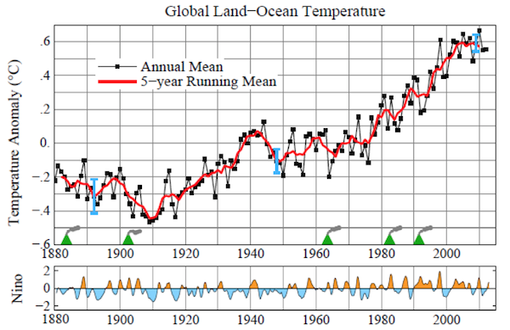
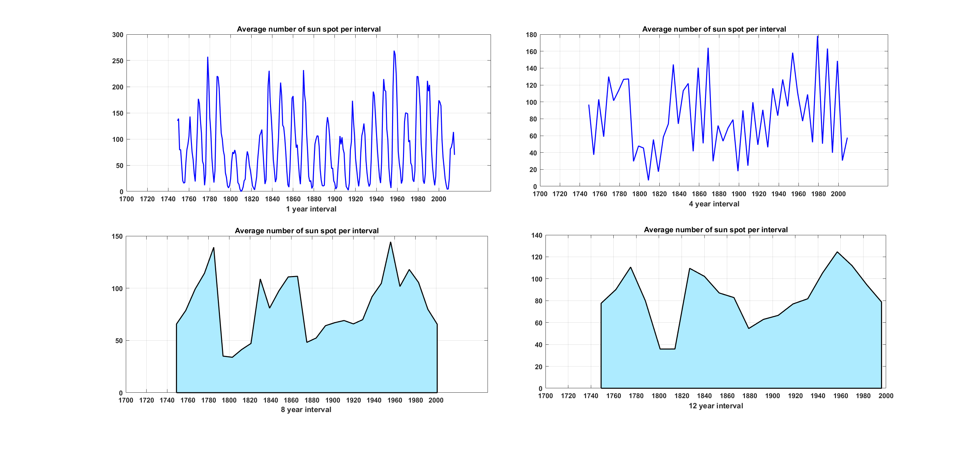
Average Sunspot Number
Monthly mean total sunspot number (1749 - Present)
Dataset available at Sunspot Index and Long-term Solar Observations (SILSO)

Slide 24
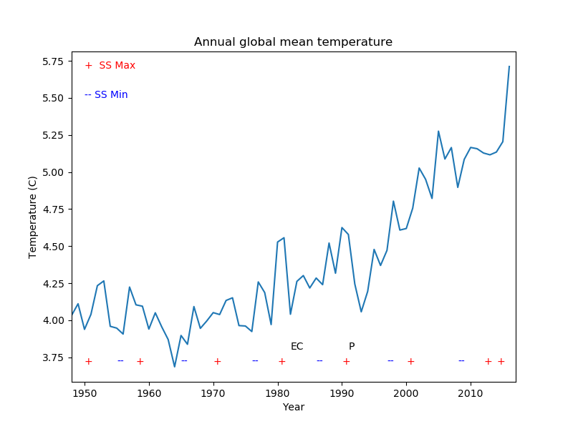
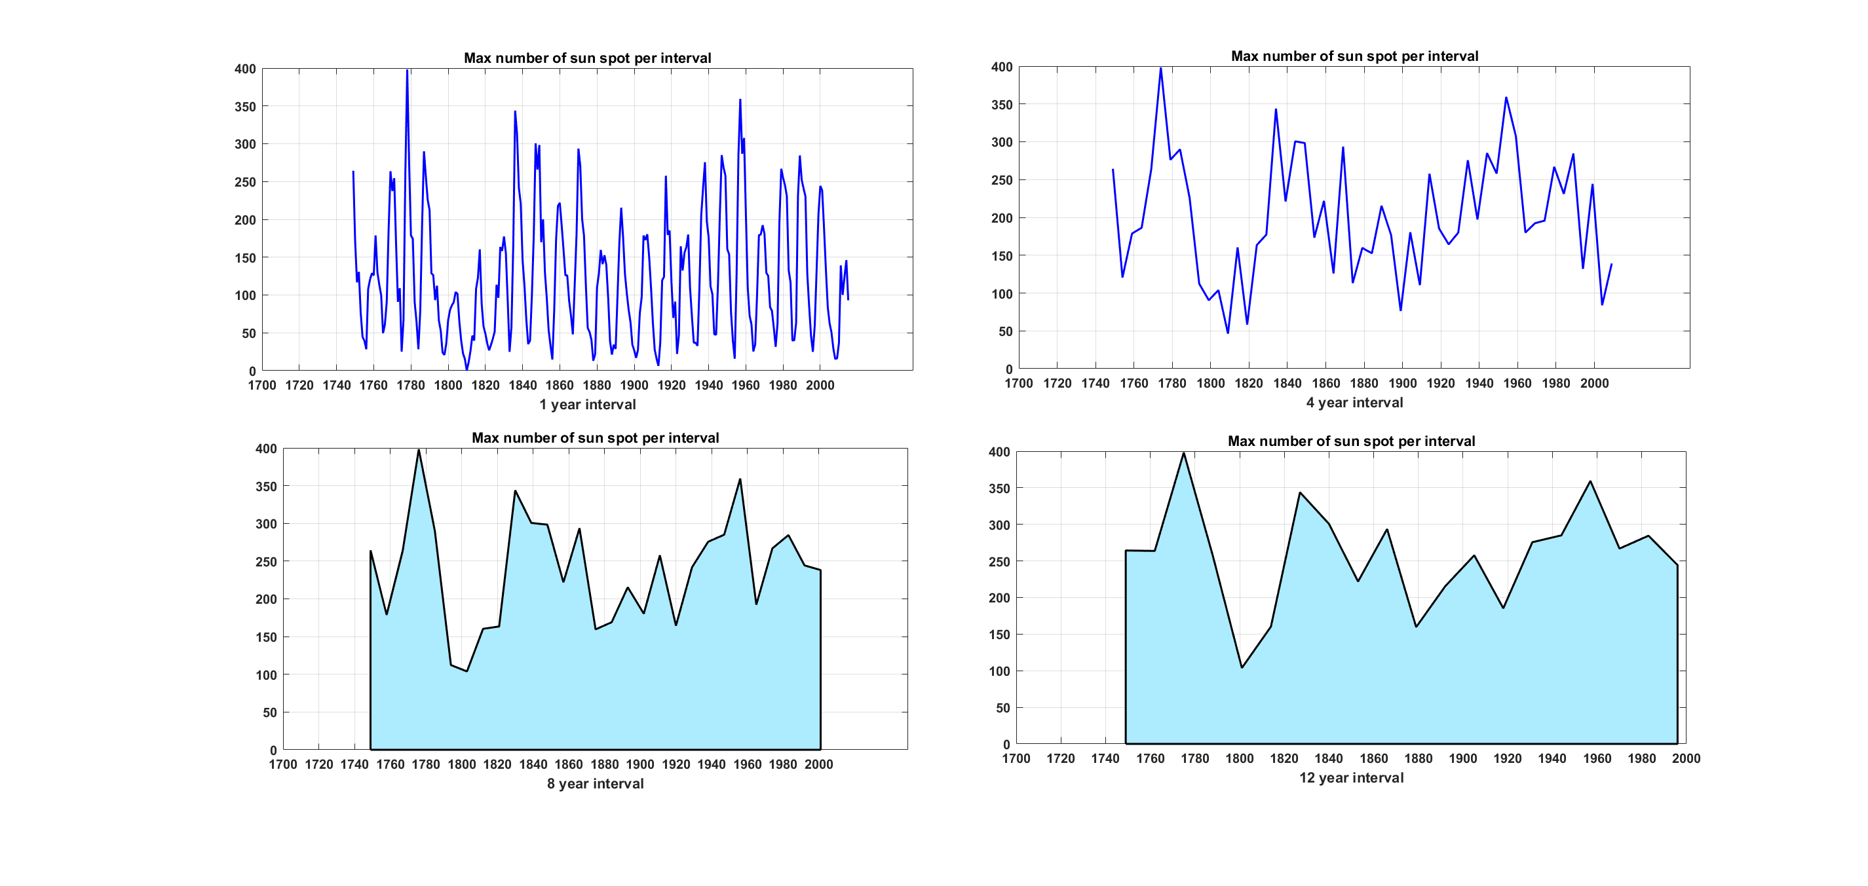
Warmest Summers From Maximum Sunspot Number Series

Slide 25
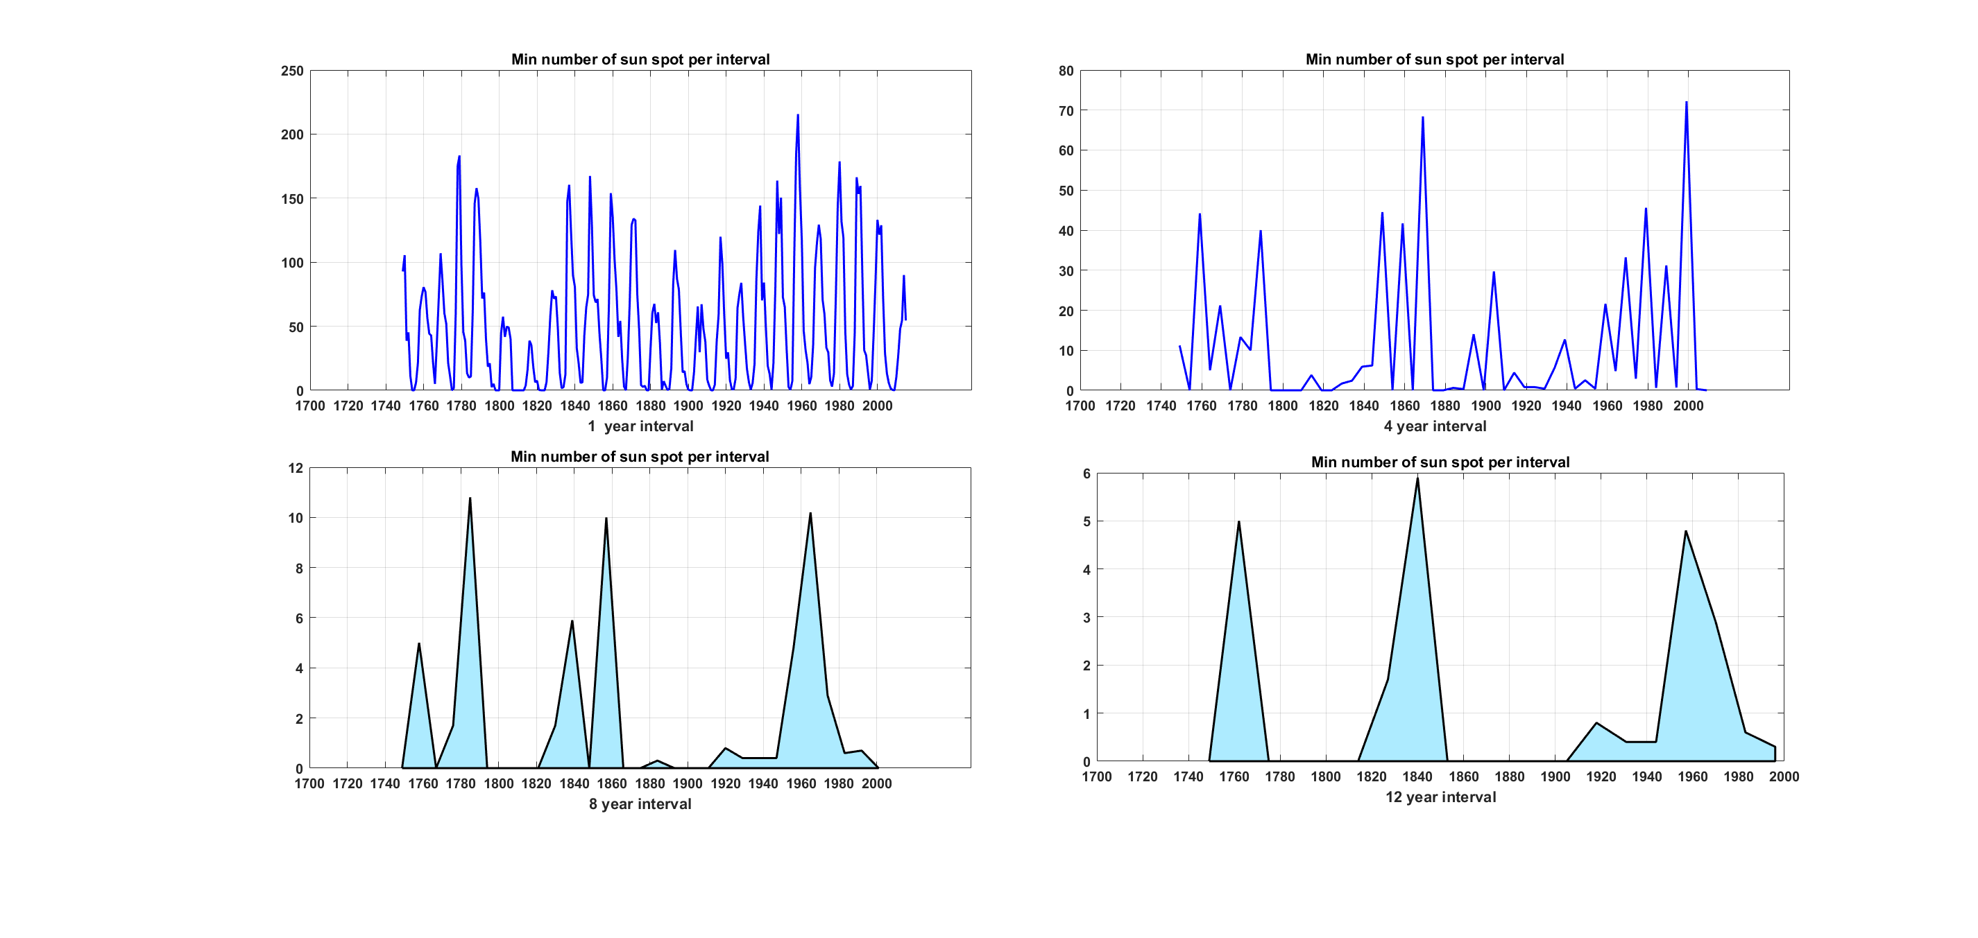
Warmest Winters From Minimum Sunspot Number Series
Notes:
Warmest winter in 1/4/8/12 year interval.
1960 warmer winters than nearby usual months
2000 should be most warm but beause of strong la nina at that time its cool

Slide 26
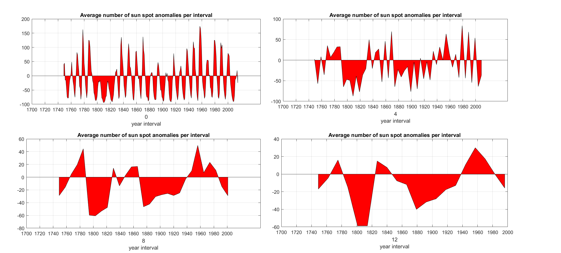
Sunspot Anomaly
Global mean sun spot number = 94.5
Warm Period
Warm Period
(Modern Maximum)
Warm Period
Cooling Period
Cooling Period
Cooling Period
(Dalton Minimum)
Cooling Period
Notes:
The Dalton Minimum was a period of low sunspot count. John Dalton, lasting from 1790 to 1830 .corresponding to the period solar cycle 4 to solar cycle 7
Modern Maximum reached maximum in late 1950s
Cooling effect now influencing the plateauing of temperature

Slide 27
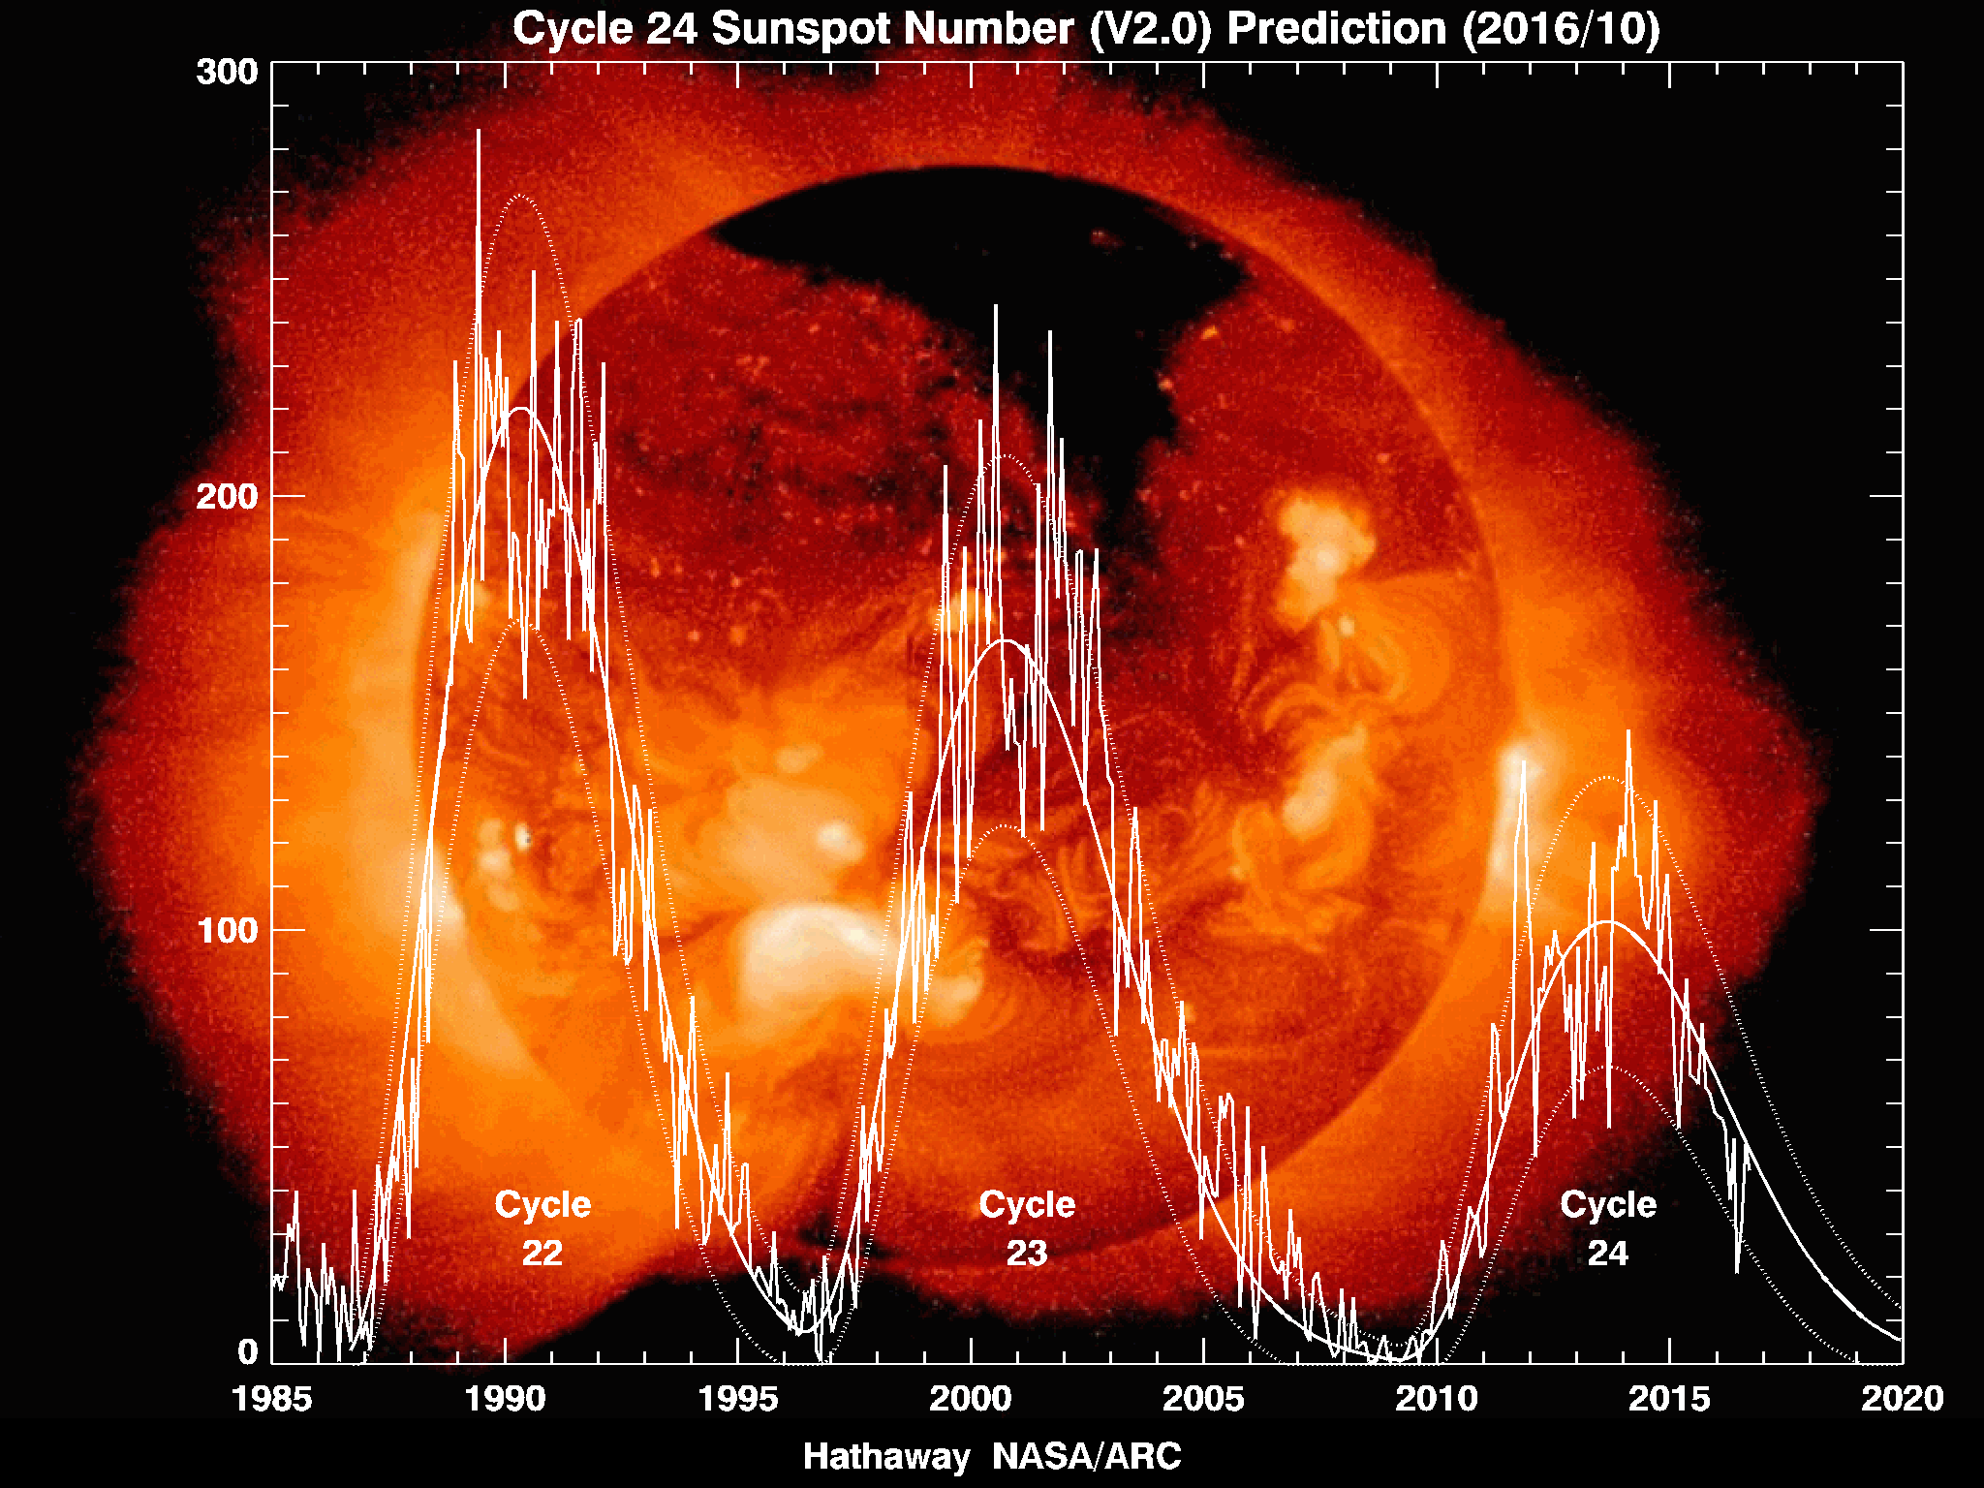

Slide 28
Summary and Conclusions
Both internal and external forcing mechanisms: i.e. ENSO, aerosols/GHGs, volcanic eruptions, and solar cycles contribute to climate variability.
Marked associative relationship between solar cycles and global/regional OLR.
Current solar cycle is expected to encompass a prolonged sunspot minimum beginning around year 2020.
How will the next solar minimum impact global temperatures?
Further exploration of the interaction between volcanic and solar (sunspot) activity is necessary.

Slide 29
References
Jagannathan, P. and H.N. Bhalme, “Changes in the pattern of distribution of southwest monsoon rainfall over India associated with Sunspots”, Mon. Wea. Rev., 101(9), 691-700 (1973).
Liebmann, B. and C.A. Smith, “Description of a complete (interpolated) outgoing longwave radiation dataset”, Bulletin of the American Meteorological Society, 77(6), 1275-1277 (1996).
Merlis, T.M., I.M. Held, G.L. Stenchikov, F. Zeng, L.W. Horowitz, “Constraining transient climate sensitivity using coupled model simulations of volcanic eruptions”, J. Climate, 27(20), 7781-7795 (2014).
Rao, Y. P., [Southwest Monsoon], India Meteorological Department, New Delhi, 2-5 (1976).
Singh, D. , Kumar, P.R., Kulkarni, M.N., Singh, R.P., and Singh, A.K., “Lightning, convective rain and solar activity – over the South/Southeast Asia”, Atmospheric Research, 120-121, 99-111 (2013).

